Slide 1

DEPARTMENT OF COMPUTER SCIENCE & ENGINEERING
SDM INSTITUTE OF TECHNOLOGY
“DIABETES prediction”
Under the guidance of
Mr. Chaitanya D
Asst. Prof.
Department of CSE
SDMIT, Ujire
Presented By
Rohan Ponnanna (4SU19CS076)
Seetaram Naik (4SU19CS088)
Srinivas S (4SU19CS101)
Sulekha PB (4SU19CS103)
TEAM ID: 2022CSEPT21

Slide 2
INTRODUCTION
All around there are numerous ceaseless infections that are boundless in evolved and developing nations. One of such sickness is diabetes.
ML strategies and neural systems help scientists to find new realities from existing well-being-related informational indexes, which may help in ailment supervision and detection.
This model can foresee whether the patient has diabetes or not, aiding specialists to ensure that the patient in need of clinical consideration can get it on schedule and also help anticipate the loss of human lives.

Slide 3
OBJECTIVES
To analyse and choosing the suitable algorithm for the early prediction of diabetes to the user.
To improve the overall accuracy of the model to get more accurate result.
To build a diet recommendation system to maintain the healthy lifestyle.
Hosting the web platform in which user can view and interact with the model.

Slide 4
METHODOLOGY
Import the required libararies and diabetes dataset.
Preprocess the data to remove the missing data and split the data into training data and testing data.
Try different machine learning algorithm to train the model.
Evaluate the model based on the accuracy of the result and choose the best model.
Implementing the user friendly interface for the user.
Building a diet recommendation system to maintain a healthy lifestyle.

Slide 5
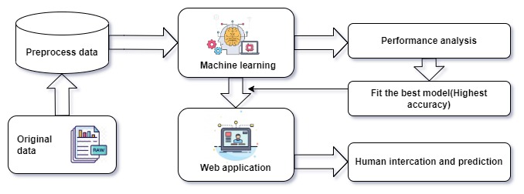
HIGH LEVEL DESIGN

Slide 6
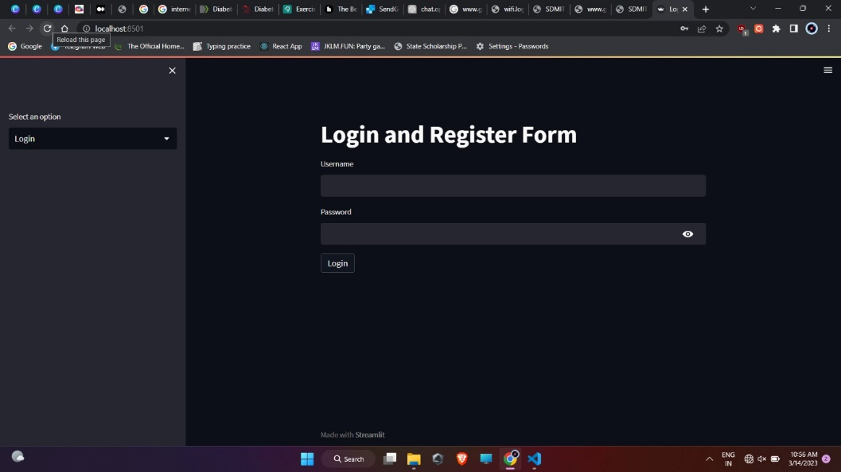
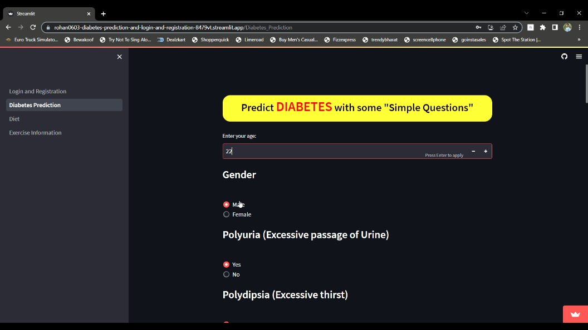
IMPLEMENTATION

Slide 7
Thank You

